Slide 1
The Age Old Debate…
Apple Or Google
By Jeremy Randolph, Youqing Ye, Shagufta Zareen, John Bibbins

Slide 2
Motivation and Summary
The comparison between Google Play Store and Apple Store never stops
Who has more game apps? Utility apps?
Whose apps are cheaper?
Whose apps have better rating?
Quantitative comparison and Visualization:
Who did it better?

Slide 3
Questions and Data
Category
Which Category has the highest share in the stores?
What is the distribution of Free and Paid apps in the stores?
Price
Does Category affect Price?
Does rating correlate to Free or Paid (Does the quality matter)?
Rating
Does Category affect rating? Are there categories that perform really good or bad?
Between the two markets who has better Apps, rating wise?

Slide 4
Questions and Data
Data Source: Kaggle.com:
AppleStore.csv
Dimension of the data set; 7197 rows and 16 columns
Googleplaystore.csv
Dimension of the data set; 10841 rows and 13 columns

Slide 5
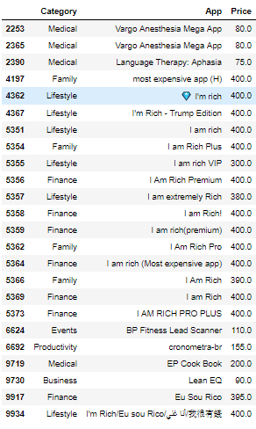
Data Cleanup
Simplifying and recategorizing applications
Google Contained Over 100 Categories
Removed junk application and outliers
Cleaned inconsistent values
Ex $., +, , , and ect..
Notes:
Jeremy & Shag

Slide 6
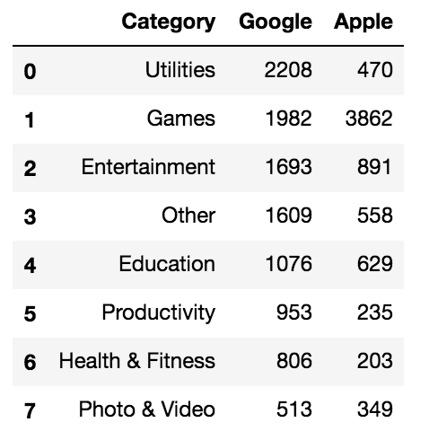
Data Analysis
Re-categorizing:
Orignial category
Common category
Common sense

Slide 7
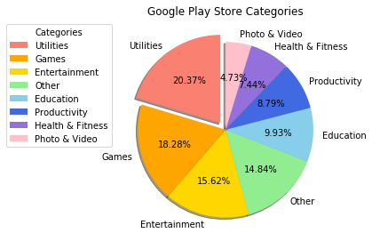
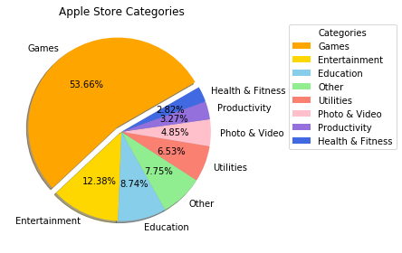
Data Analysis
Utilities, Games, Entertainment… Games! Games! Games!

Slide 8
Data Analysis
Rating Questions
Does Category affect rating? Are there categories that perform really good or bad?
Between the two markets who has better Apps, rating wise?

Slide 9
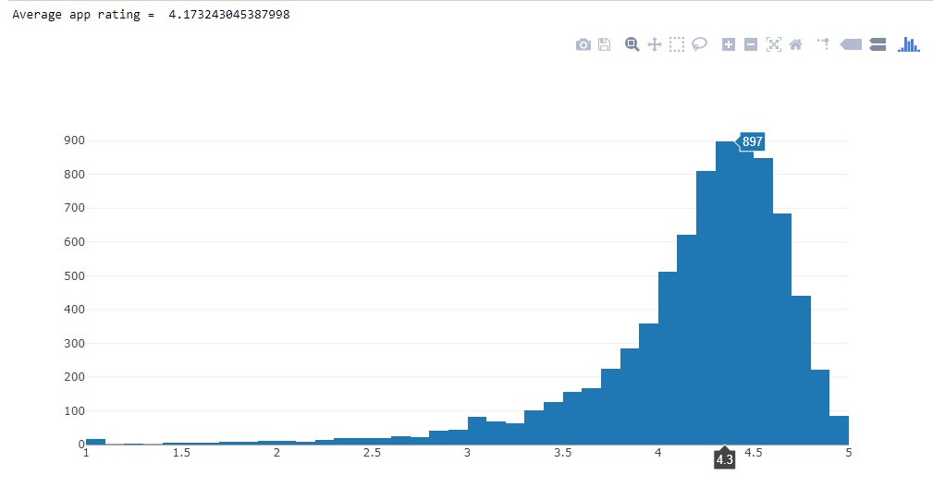
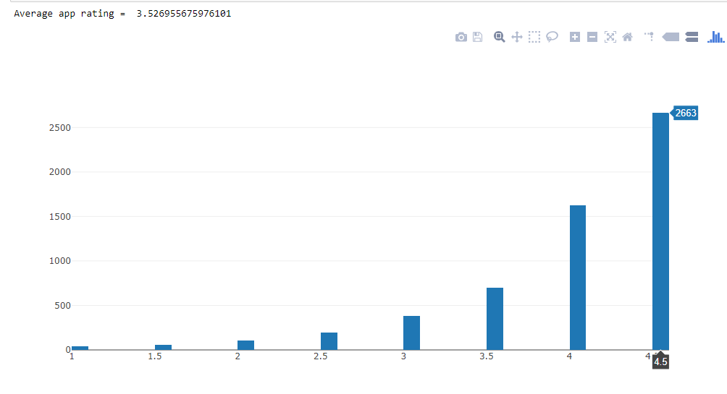
Data Analysis
Google Play Store
Apple App Store

Slide 10
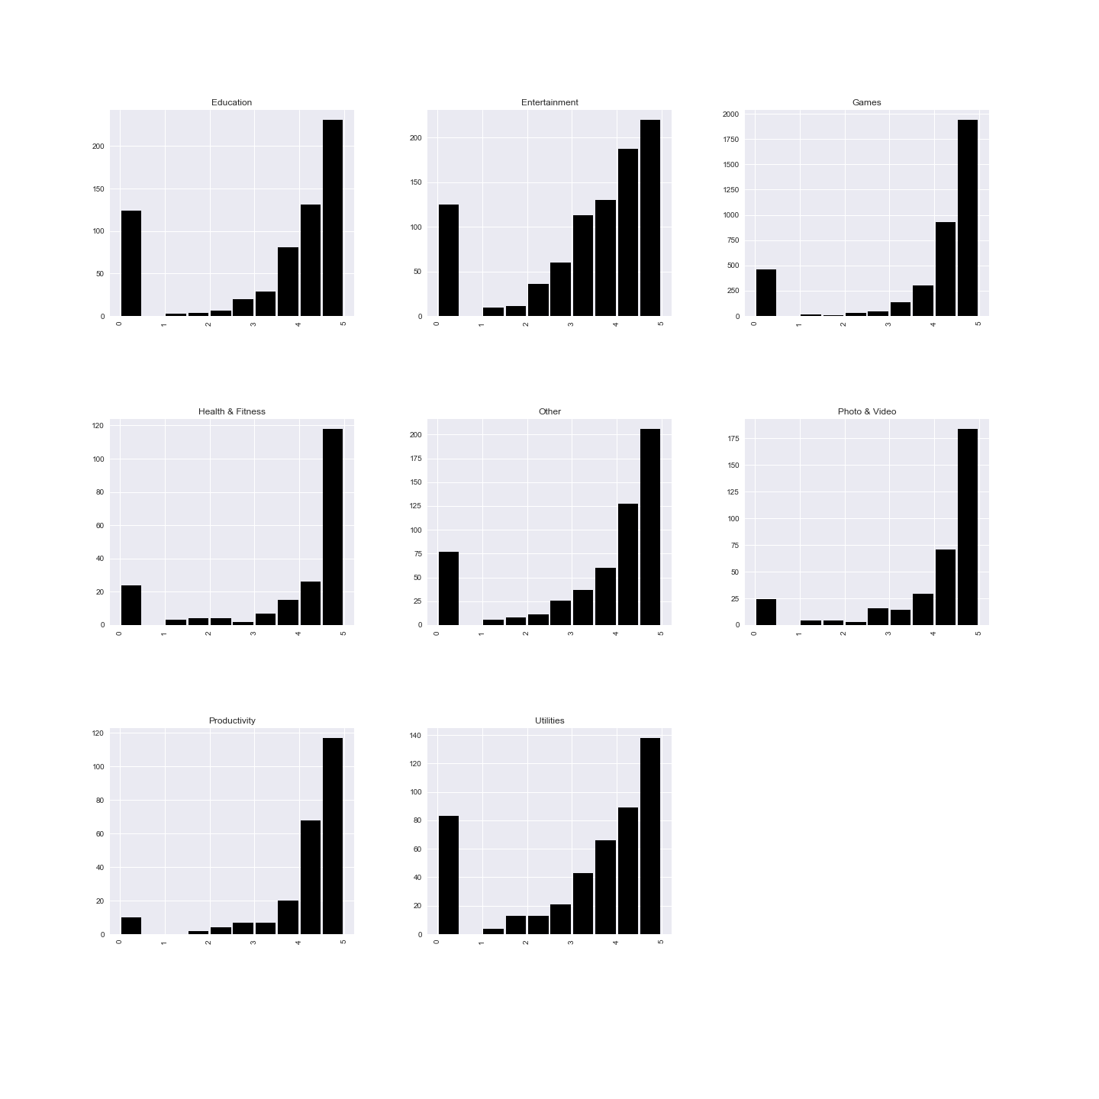
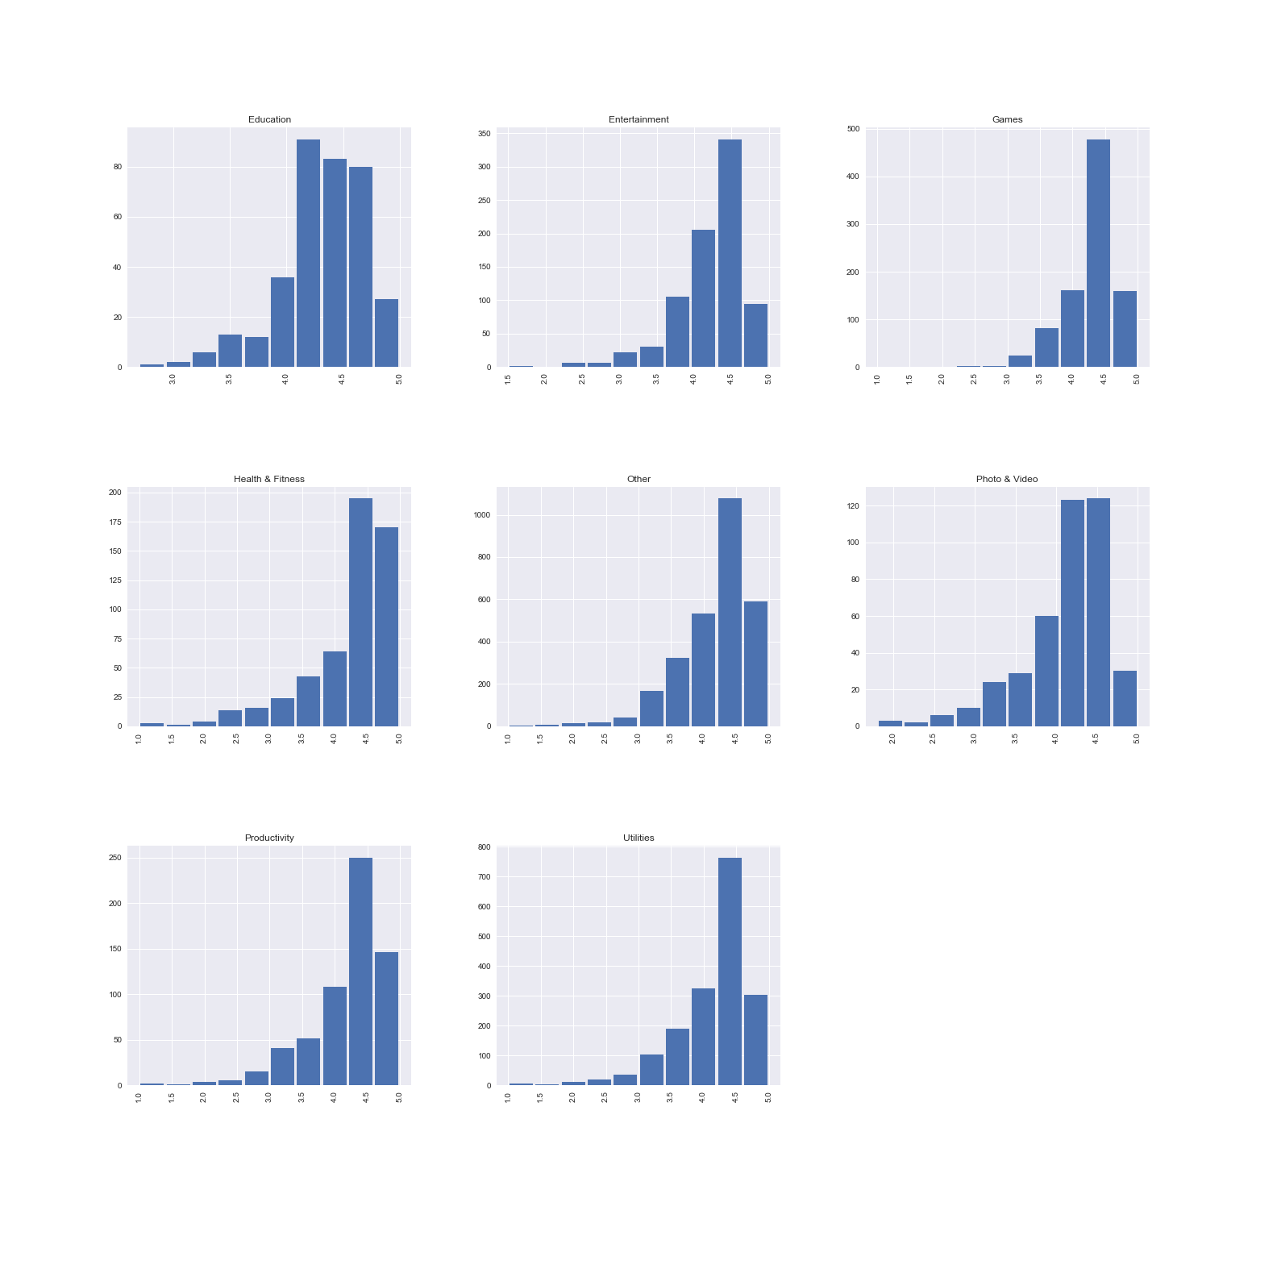
Data Analysis
Google Play Store
Apple App Store

Slide 11
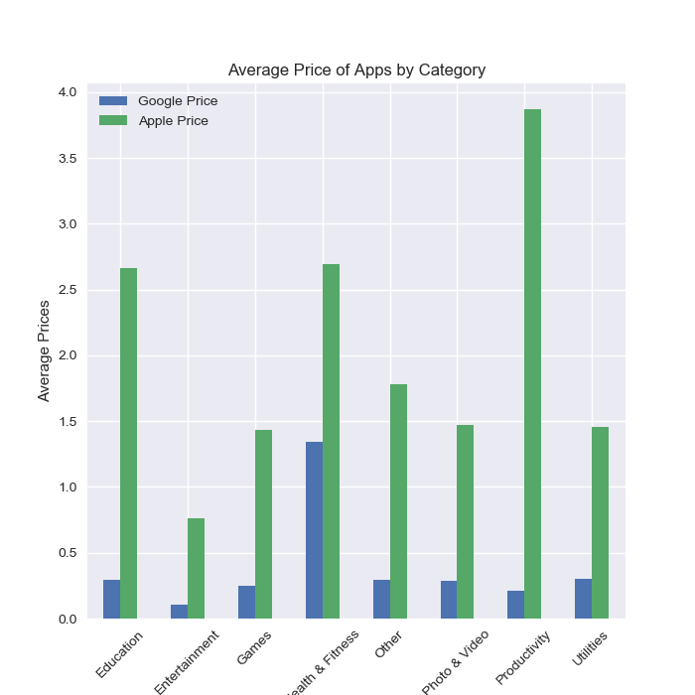
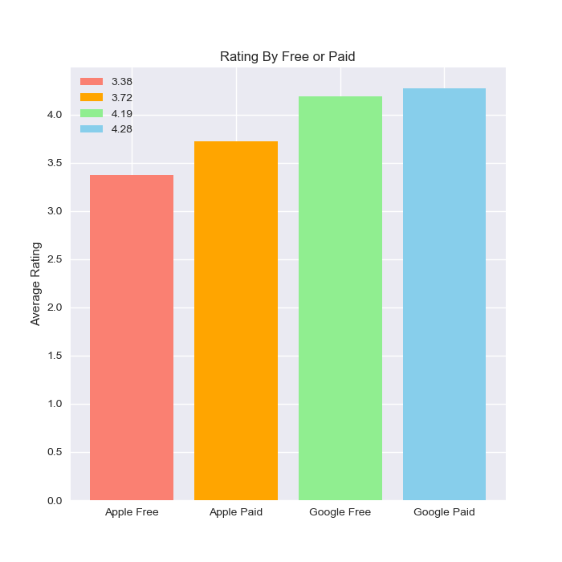
Data Analysis
Notes:
Jeremy

Slide 12
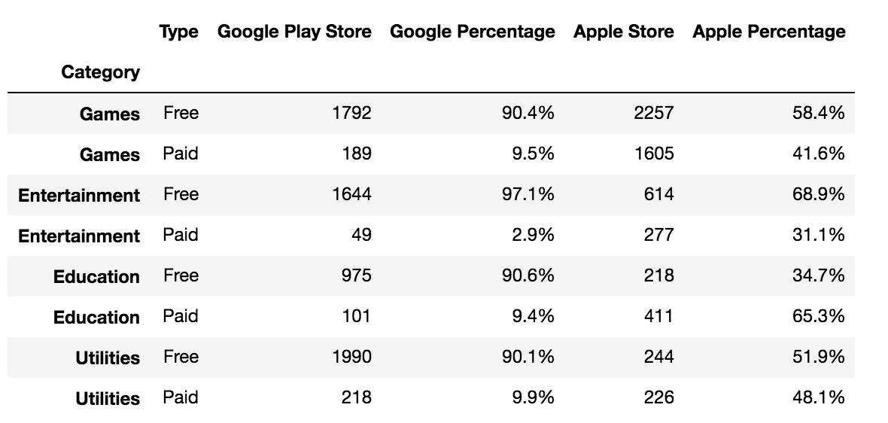
Data Analysis

Slide 13
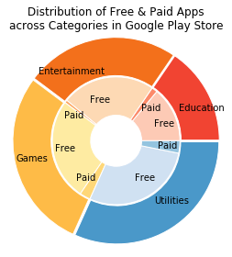
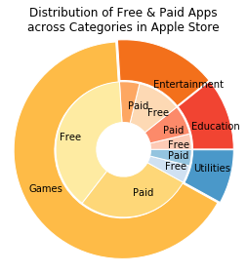
Data Analysis
I don’t want to pay! I could pay...

Slide 14
Discussion
Different Marketing Strategy - Apple: Game lover
- Google: All-rounder
More paid app in Apple Store vs More free app in Google Play Store
Better rating in Google Play Store than Apple Store
Lower price in Google Play Store than Apple Store

Slide 15
Post Mortem
Too many categories, had to group in to a smaller set
Apple did not have number of installs
If we had 2 extra weeks
Look into in-app purchases for the “freemium” applications
Get revenue data for the two companies

Slide 16
Questions?

